Slide 1
Workgroup Updates
February 22, 2024
Notes:
High Level Overview

Slide 2
Regulation 22 Workgroup 2024 January 29, 2024
CDPHE Webpage: https://cdphe.colorado.gov/water-quality/water-quality-engagement/reg-22-site-location-and-design-regulations-for-domestic
Agenda: https://docs.google.com/document/d/1FiZ1Qsevoc0VhIyI0HGhHta2j4jMa1fEvBS9V8COnt8/edit?usp=drive_link
Workgroup Folder: https://drive.google.com/drive/folders/10J1dXBQIu07Z38LnAVPdhq-l-Kg_iRqw
Construction Flexibility visual scenarios.
Preliminary proposed redlines for construction flexibility. PDF in the workgroup flexibility folder. Or directly view here: https://drive.google.com/file/d/1X9wsw2fsrT1vRDWbUs0pUuTYkWdxZOSz/view?usp=sharing,
Redundancy and resiliency requirements must be met for each constructed treatment capacity.
Treatment entity responsible to construct for current and future wastewater treatment capacity. WQCD to track documentation of constructed treatment capacity.

Slide 3
Regulation 22 Workgroup 2024 January 29, 2024
See Regulation 22 redlines at line #s 201-204; 6370-6406;
3

Slide 4
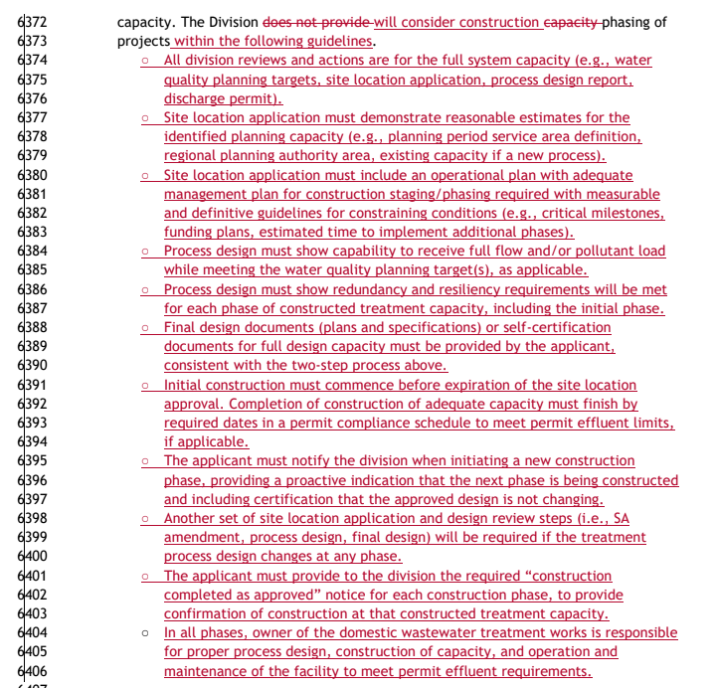

Slide 5
Regulation 22 Workgroup 2024 January 29, 2024
Historical infrastructure - Stakeholder feedback on the interim approach in Appendix C of the Regulation 22 Implementation Policy.
Expect to discuss more in the February 26th meeting
Conceptual examples
The division is considering expectation for SA/DR of historic lift stations under the following situations:
Changes to the historic lift station (updating). Note: In-kind replacement would not apply to historic lift station without SA/DR.
New infrastructure being installed resulting in changes to the service area of the historic (e.g., new lift station adding flow to the existing historic lift station).
Sanitary sewer overflow (SSO) discharge(s) that indicate operational issues at the historic lift station.
Conditions identified that indicate operational issues at the historic lift station (e.g., at a compliance evaluation inspection (CEI)).

Slide 6
CMF Strategic Meeting January 30, 2024
Identify and engage participants, NGOs, etc., that were not represented at this meeting.
Develop a Communications Plan that outlines a clear mission, long-term water quality vision/plan, and immediate needs list.
Identify the point of contact for certain issues – these individuals will be the lead with support from others on important issues the group should direct resources to.
Leverage existing overlap between CMF and the Water Quality Forum (WQF) Steering Committee and attempt to harmonize these efforts.
Be an active voice and participant at:
The feasibility workgroups that begin on March 21st.
Commission Town Hall and Public Forum on October 15th.

Slide 7
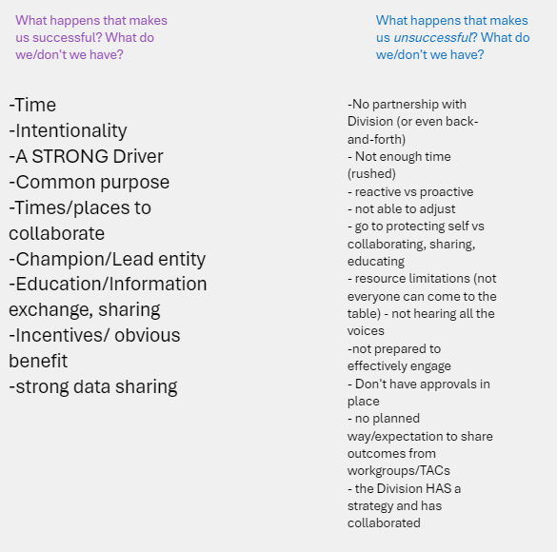
CMF Strategic Meeting January 30, 2024

Slide 8
CMF Strategic Meeting January 30, 2024
Groups not present whom we should be coordinating with.

Slide 9
Temperature Assessment Training Session January 31, 2024
Meeting agenda link: https://docs.google.com/document/d/1YXYBA2BmWgjV8oHhgFgDhTKsP4DrHQr3uxjgJ4FBZaM/edit?usp=sharing
Lorie Petersen, Skip Feeney, Robert Hillegas, Aimee Konowal
To Explain the temperature assessment process for 303d assessments.
Meeting is recorded and will be available.
See Assessment Calculation at: https://cdphe.colorado.gov/surface-water-assessment
The stepwise instructions are currently available in this public folder: https://drive.google.com/drive/folders/1I8Yd6Hvyg8XFx0iEY7YVZiyHT3gMG9GZ

Slide 10
Clean Water Funding Mix February 5, 2024
Meeting agenda here: https://docs.google.com/document/d/1UW8oVYml7pBn2ckjvsK64lrjRS5ABJHPZ_hS6ZeS3Js/edit?usp=sharing
Workgroup Docs: These are the slides (16-18) on the two approaches (i.e., Individual vs. General Permits)https://docs.google.com/presentation/d/1nyhMcEVIOPZWzcZHDcnKHHDy3JDdD46Jot_IGmHfBno/edit#slide=id.p16
Link to the Clean Water resources folder: https://drive.google.com/drive/folders/1qGGdnUO_o7Dx6_f1iPpohG2dqFmz8qG2

Slide 11
Clean Water Funding Mix February 5, 2024

Slide 12
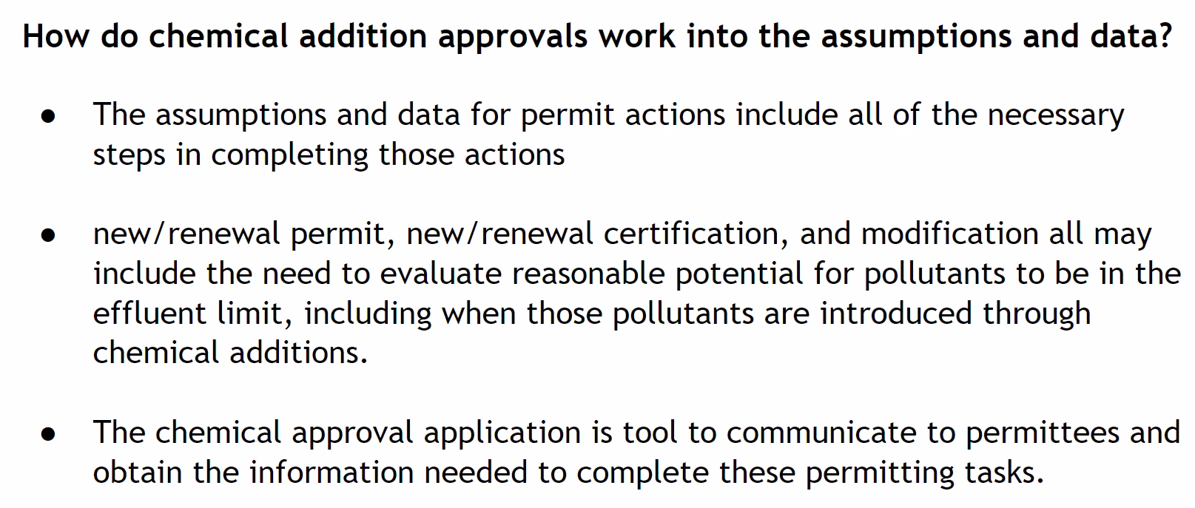
Clean Water Funding Mix February 5, 2024

Slide 13
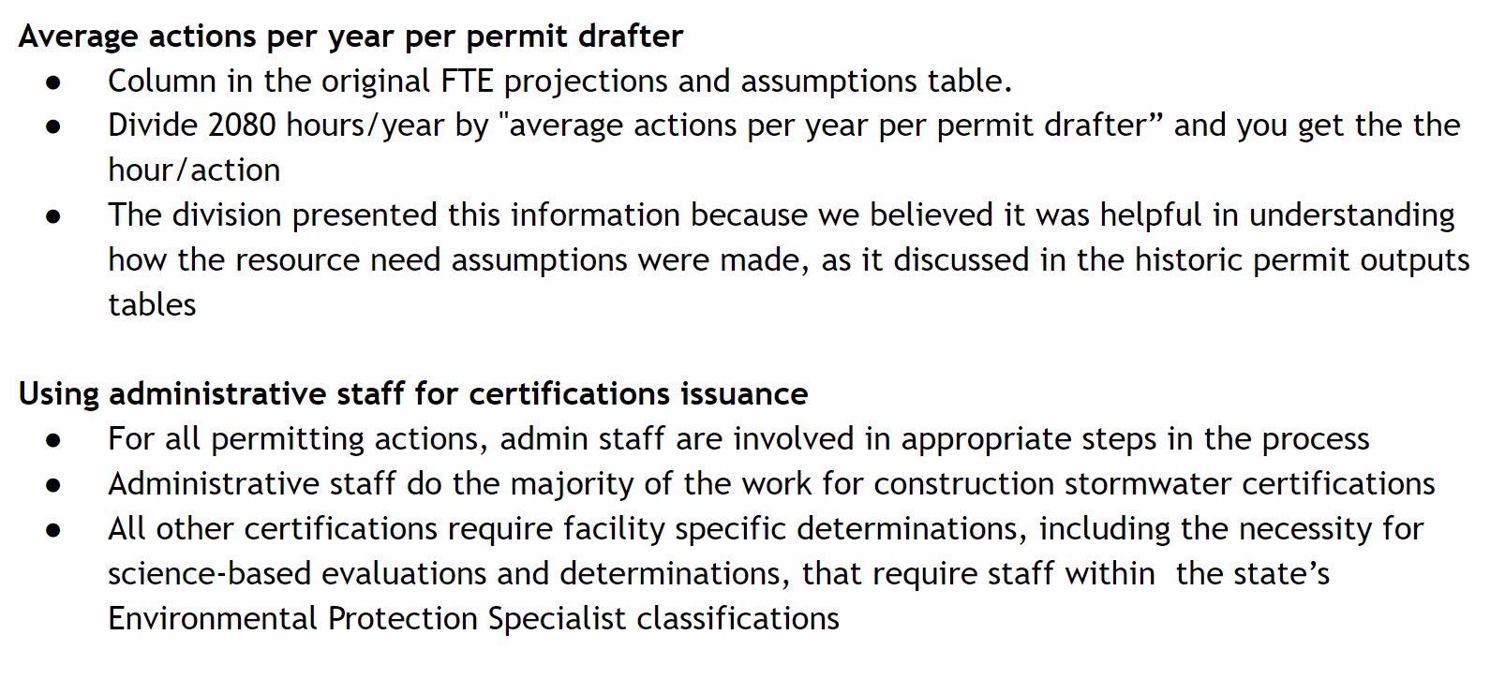
Clean Water Funding Mix February 5, 2024

Slide 14
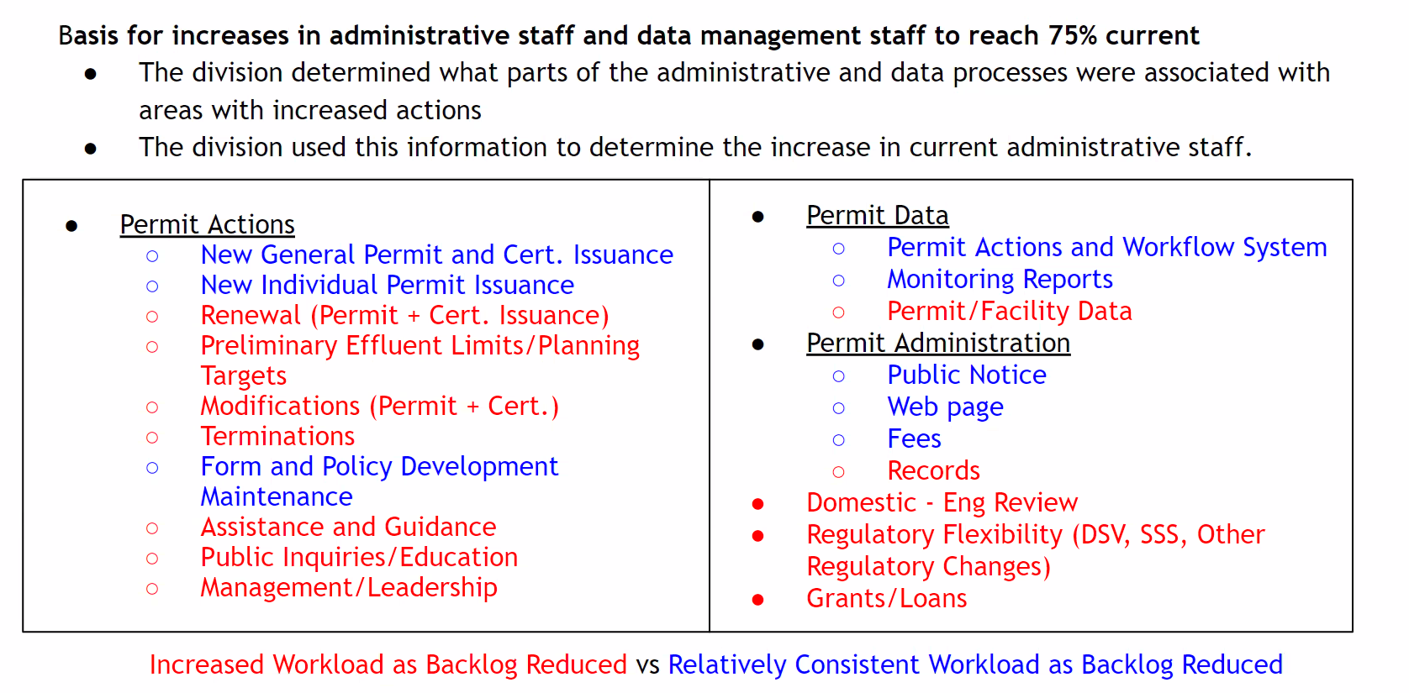
Clean Water Funding Mix February 5, 2024

Slide 15
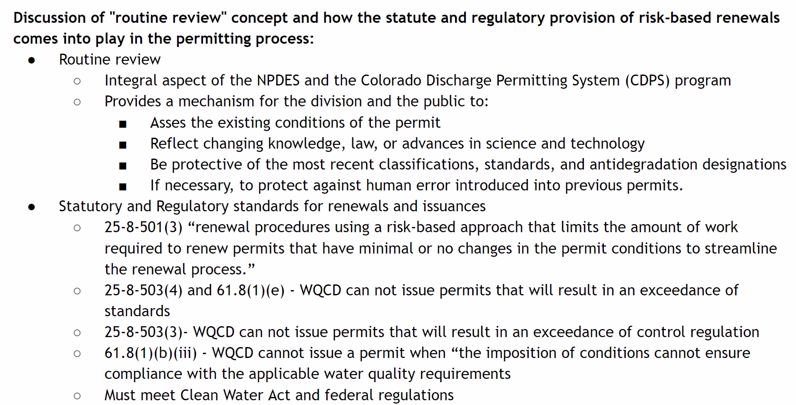
Clean Water Funding Mix February 5, 2024

Slide 16
Clean Water Funding Mix February 5, 2024

Slide 17
CWWUC February 14, 2024
Presentation with CDPHE and CPW regarding Temperature Warming Events - Skip Feeney, Melynda (Misty) May, Ashley Rust, Lorie Petersen, and Aimee Konwal with the Division and CPW.
Regulatory Updates –
PFAS Bill – SB 24-081 – https://leg.colorado.gov/bills/sb24-081
Regulate Dredged & Fill Material State Waters SB 24-127 - https://leg.colorado.gov/bills/sb24-127
Green Infrastructure for water quality management - SB 24-037 – https://leg.colorado.gov/bills/sb24-037

Slide 18
Clean Water Fees
The next Clean Water fees subgroup meeting is 2/21 at 3pm, and the next large stakeholder meeting is 2/26 at 9 am. Info here: https://cdphe.colorado.gov/water-quality/water-quality-engagement/water-quality-fee-setting-rule.
For those interested in the 1st rulemaking, materials are being posted here: https://drive.google.com/drive/folders/1v1HlJvMDcVCAmRdNNJw43mksREH_UUal

Slide 19
Questions
Email: mthomas@nfrwqpa.org

